Slide 1
INDIA AIR QUALITY INDEX
CSE3020
DATA VISUALIZATION
FINAL REVIEW
MENTOR DETAILS:
Dr. Joshan Athanesious J
School of Computer Science and Engineering
Vellore Institute of Technology (VIT), Chennai
TEAM MEMBERS:
Sanjil K C – 20BCE1855
Mahir – 20BCE1524

Slide 2
ABSTRACT
Examining and protecting air quality has become one of the most essential activities for the government in many industrial and urban areas today. The meteorological and traffic factors, burning of fossil fuels, and industrial parameters play significant roles in air pollution.With this increasing air pollution,We Are in need of implementing models which will record information about concentrations of air pollutants(so2,no2,etc).The deposition of this harmful gases in the air is affecting the quality of people’s lives, especially in urban areas. Lately, many researchers began to use Big Data Analytics approach as there are environmental sensing networks and sensor data available.
In this paper, machine learning techniques are used to predict the concentration of so2 in the environment. Sulphur dioxide irritates the skin and mucous membranes of the eyes, nose, throat, and lungs.Models in time series are employed to predict the so2 readings in nearing years or months.

Slide 3
BACKGROUND
In the developing countries like India, the rapid increase in population and economic upswing in cities have lead to environmental problems such as air pollution, water pollution, noise pollution and many more. Air pollution has direct impact on humans health .There has been increased public awareness about the same in our country.Global warming, acid rains, increase in the number of asthma patients are some of the long-term consequences of air pollution. Precise air quality forecasting can reduce the effect of maximal pollution on the humans and biosphere as well. Hence, enhancing air quality forecasting is one of the prime targets for the society. Sulphur Dioxide is a gas.
It is one of the major pollutants present in air.It is colorless and has a nasty, sharp smell.It combines easily with other chemicals to form harmful substances like sulphuric acid, sulfurous acid etc. Sulfur dioxide affects human health when it is breathed in. It irritates the nose, throat, and airways to cause coughing, wheezing, shortness of breath, or a tight feeling around the chest. The concentration of sulphur dioxide in the atmosphere can influence the habitat suitability for plant communities, as well as animal life. The proposed system is capable of predicting concentration of Sulphur Dioxide for forthcoming months / years.

Slide 4
RESEARCH OBJECTIVES
Through our project we aim to find the Air Quality Index (AQI) Range state wise based on the amount of pollutants that affect the air whose values are present in the dataset.
From the range, we can find the states that are contributing majorly towards the lower air quality.
From the arrived conclusion, systematic steps can be taken to give more importance where it is required. This helps to effectively reduce the pollution levels nationwide.
In this project we also predict the value of the air quality index and the air quality index range based on the measurements using multiple machine learning models.

Slide 5
LITERATURE REVIEW
Previous studies show the need to implement efficient air quality monitoring models which collect information about the concentration of air pollutants and provide assessment of air pollution in each area. The aim of this research paper is to investigate various for air quality forecasting.
The nature of air is impacted by multi-faceted elements including area, time, and unsure factors. Past investigates show to think about elements, for example, of air contaminants like NO2,CO, Ground level O3,SO2, PM2.5(particulate matter with diameter of 2.5*(10^-6)m), PM10, and meteorological data like temperature, pressure, humidity, wind speed, wind direction.
Metrics used for evaluating the predictive models were Root Mean Square Error, Normalised Root Mean Square Error, Mean Absolute Error, Symmetric Mean Absolute Percentage Error and Pearson correlation coefficient. The results showed that compared to other methods, SLI-ESN (hybrid Scalable Link Interface-Echo state networks) performed better results

Slide 6
It can be noted that most extensive research has been done in China which is leading this kind of works with 26 papers, followed by nations like Italy, Spain, USA, and more.
we can conclude that
-Rather than utilizing straightforward AI strategies, presently, the authors apply advanced and sophisticated techniques like gradient boost algorithms, random forest, Neural networks, back propagation
-China was the leading main nation as far as such investigations are considered.
-Particulate matter with measurement equivalent to 2.5 micrometers was the fundamental expectation target.

Slide 7
DATA COLLECTION
The data set we used was obtained from Kaggle.
Link – https://www.kaggle.com/datasets/shrutibhargava94/india-air-quality-data
About the Dataset:
Using the above-mentioned dataset, India's air pollution levels can be explored at a more granular scale.
This data is combined (across the years and states) and largely clean version of the Historical Daily Ambient Air Quality Data released by the Ministry of Environment and Forests and Central Pollution Control Board of India under the National Data Sharing and Accessibility Policy (NDSAP).

Slide 8
DATA ANALYSIS APPROACHES
Data Analysis is going to be done using two approaches..
State-wise Data Visualization and Analysis.
Air Quality determinant sample wise Visualization and Analysis.
The State-wise Data Visualization will give results like the maximum polluted state and minimum polluted state, state containing highest concentration of SO2, NO2, etc.
Air Quality Determinant Samples included in the dataset are: SO2, NO2, RSPM, P2.5.
From these measurements we have calculated indexes of each of the samples and then from those have derived a global Air Quality Index of that particular record. To classify the index or to make it more reader friendly, we have calculated an AQI Range i.e Good, Healthy, etc.

Slide 9
TACKLING THE MISSING VALUES
(DATA PREPROCESSING)
After reviewing all of the attributes, it was determined that stn_code, location_monitoring_station, and sampling_date were unnecessary. As a result, were removed.
When the last three rows of the dataset are examined, it is discovered that they lack any information that would aid in analysis, so they are removed.
Categorical Data –
Missing values in ‘agency’ attribute were replaced by ‘unknown’.
In the ‘date’ attribute, it is observed that it is a repetitive attribute in small range so, we felt replacing NA values in with last observed date would be the best action.
Similarly, in ‘type’ attribute too, we replaced NA values with previously observed type value.

Slide 10
Numerical Data –
Replaced NA SO2, NO2 and RSPM values with mean value state wise.
SPM and PM2_5 majorly have NA values so they were replaced by 0.
Advantages –
· By removing the unnecessary attributes, we reduce the time and load on computing required to analyse the data using various models.
· By imputing missing values with mean, data loss is prevented.
· The vast majority of SPM and PM2_5 values are absent. As a result, imputing with 0 is the best option to avoid data loss.
Disadvantages –
· By imputing missing values with mean, covariance between features will not be factored.
· If the percentage of missing values is less, by imputing with 0 there will be a data loss.

Slide 11
LIBRARIES USED
Tensorflow – It is an open-source numerical computation library that makes machine learning and neural network development faster and easier.
Keras - it is a high-level, deep learning API developed by Google for implementing neural networks.
Numpy – It is a library that adds support for large, multi-dimensional arrays and matrices, as well as a large set of high-level mathematical functions for working with these arrays.
Matplotlib – It is a large Python library for creating static, animated, and interactive visualisations.
Seaborn – It is a library that plots graphs using Matplotlib. It'll be used to visualize random distributions.
Tidyverse – It is a set of essential R packages for data scientists. The tidyverse packages assist us in performing and interacting with the data.
Ggplot2 - It is a plotting package that includes commands for creating complex plots from data in a data frame.
Tidyr – It has three main functions for cleaning up your messy data. It improves dplyr's data manipulation and pre-processing capabilities.
Dplyr - It is a data manipulation grammar, providing a consistent set of verbs to assist you in solving the most common data manipulation challenges.
Zoo - It is designed to handle irregular time series of numeric vectors/matrices, but it also handles regular time series.

Slide 12
PROPOSED SYSTEM

Slide 13
INTRODUCTION
Retrieve the dataset from Kaggle and import it into RStudio.
Do Data Visualization and Preprocessing of unprocessed data in R.
Export the Preprocessed data in a csv file and then onto Jupyter notebook.
Construct various Machine Learning models and evaluate the predictions for predicting AQI. (Regression)
Construct various Machine Learning models and evaluate the predictions for predicting AQI Range. (Classification)
Use Artificial Neural Networks and create a sequential model using various Layers like Dense Layers and Dropout Layers.

Slide 14
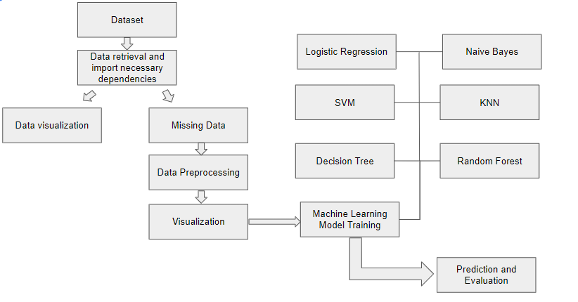
DIAGRAM

Slide 15
DIAGRAM

Slide 16
MODULES (LIST)
Linear Regression
Random Forest Regressor
ANN
ANN (Classification)
Ridge Regression
Ridge Regression
Logistic Regression
Random Forest Classifier
KNN
Weighted KNN
AdaBoost Classifier
XGBoost Classifier

Slide 17
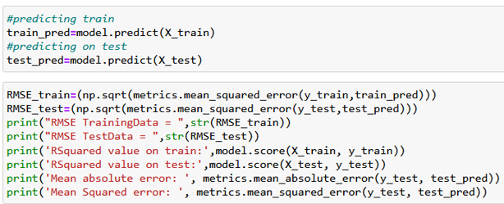
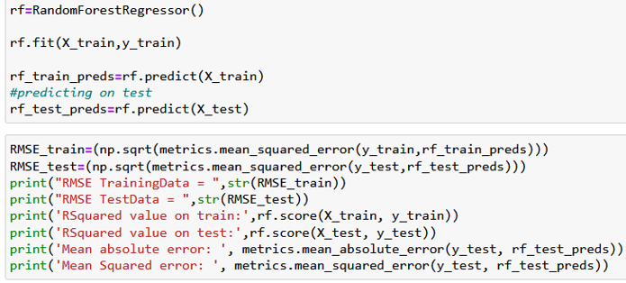
MODULES (EXPLANATION)
Linear Regression
Linear regression is a statistical method for modelling the relationship between a scalar response and one or more explanatory variables. Simple linear regression is used when there is only one explanatory variable; multiple linear regression is used when there are more than one.
RandomForest Regressor
A supervised learning technique called Random Forest Regression leverages the ensemble learning approach for regression. The ensemble learning method combines predictions from various machine learning algorithms to provide predictions that are more accurate than those from a single model.

Slide 18
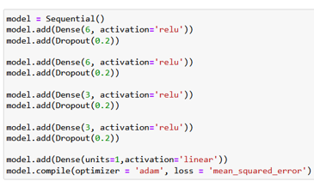
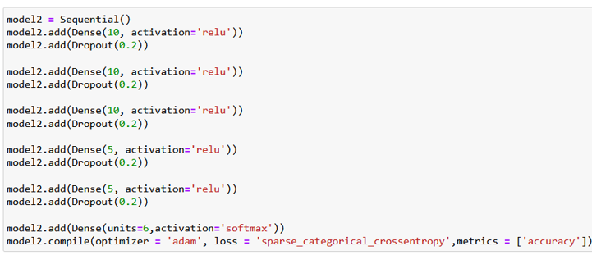
ANN
A computational model known as an artificial neural network (ANN) comprises of many processing components that accept inputs and produce results in accordance with predetermined activation functions.
ANN (Classification)
An observation is classified as belonging to a discrete class according to the inputs using classification ANNs.

Slide 19
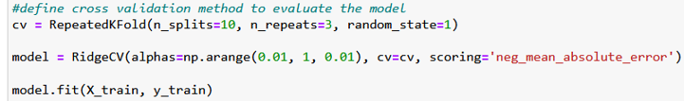
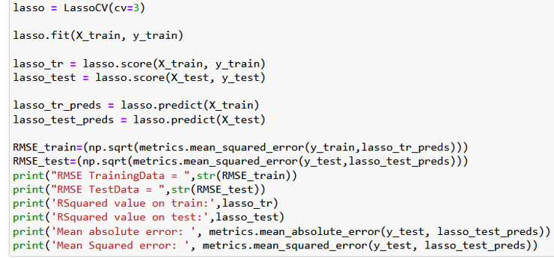
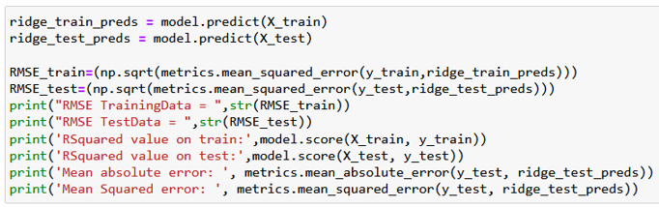
Ridge Regression
Any data that exhibits multicollinearity can be analysed using the model tuning technique known as ridge regression. This technique carries out L2 regularisation.
Lasso Regression
An approach to regularisation is lasso regression. For a more accurate forecast, it is preferred over regression techniques. Shrinkage is used in this model.

Slide 20
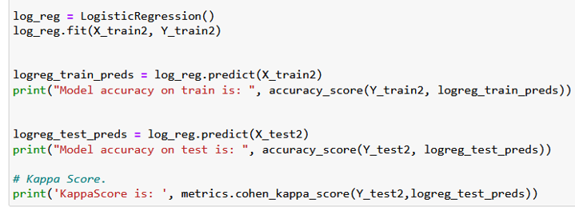
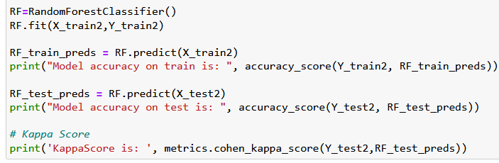
Logistic Regression
A statistical analysis method called logistic regression uses previous observations from a data set to predict a binary outcome, such as yes or no. By examining the correlation between one or more already present independent variables, a logistic regression model forecasts a dependent data variable.
Random Forest Classifier
A classification system made up of several decision trees is called the random forest. It attempts to produce an uncorrelated forest of trees whose forecast by committee is more accurate than that of any individual tree by using bagging and feature randomness when generating each individual tree.

Slide 21
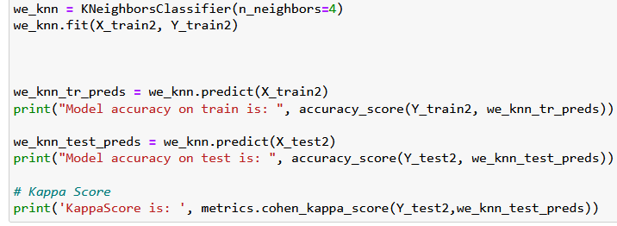
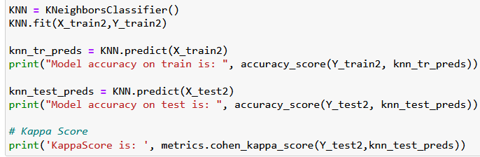
KNN
The k-nearest neighbours algorithm, sometimes referred to as KNN or k-NN, is a supervised learning classifier that employs proximity to produce classifications or predictions about the grouping of a single data point.
Weighted KNN
Using two or more numerical predictor variables, the weighted k-nearest neighbours (k-NN) classification algorithm is a straightforward method for predicting an item's class.

Slide 22

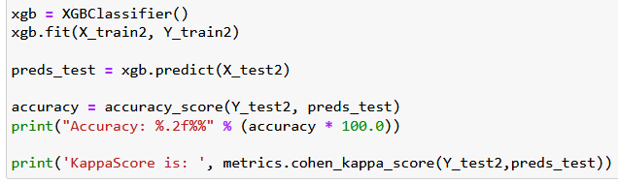
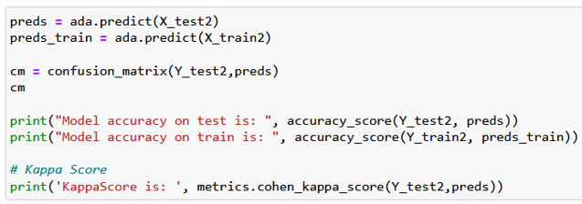
AdaBoost Classifier
AdaBoost is an ensemble learning technique that was initially developed to boost the performance of binary classifiers (sometimes referred to as "meta-learning"). AdaBoost uses an iterative process to improve poor classifiers by learning from their errors.
XGBoost Classifier
Gradient Boosted decision trees are implemented using XGBoost technology. Decision trees are generated sequentially in this approach. Weights are significant in XGBoost. Each independent variable is given a weight before being fed into the decision tree that forecasts outcomes.

Slide 23
RESULTS AND DISCUSSION

Slide 24
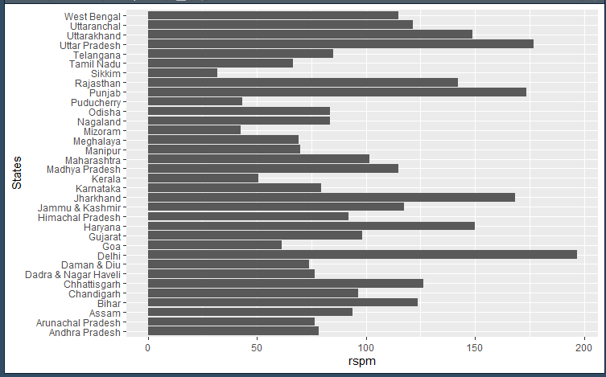
R STUDIO VISUALIZATION
State-wise RSPM

Slide 25
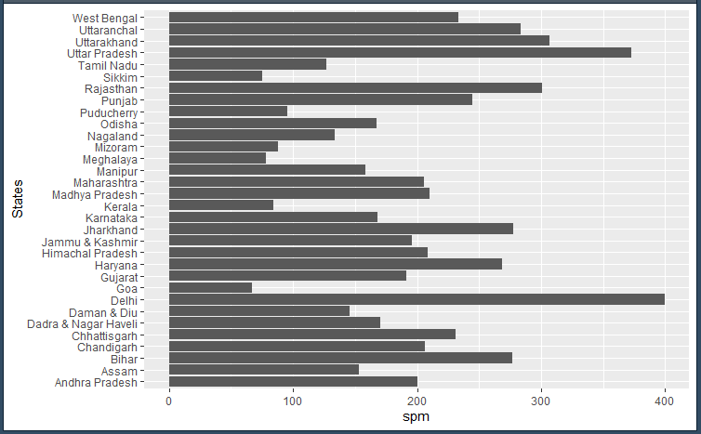
R STUDIO VISUALIZATION
State-wise SPM

Slide 26
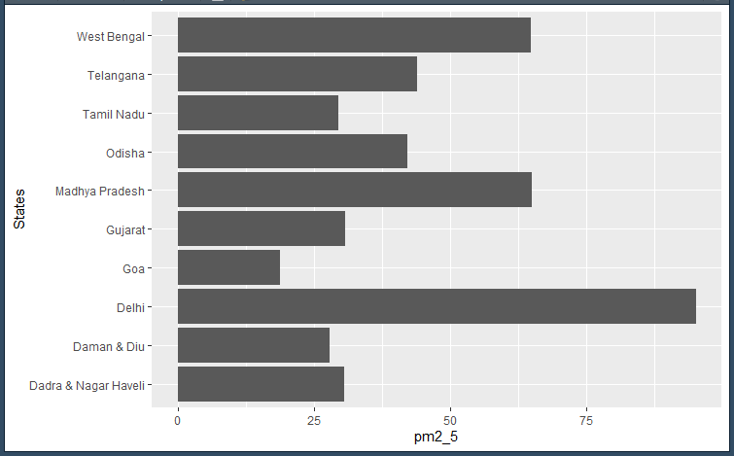
R STUDIO VISUALIZATION
State-wise PM2_5

Slide 27
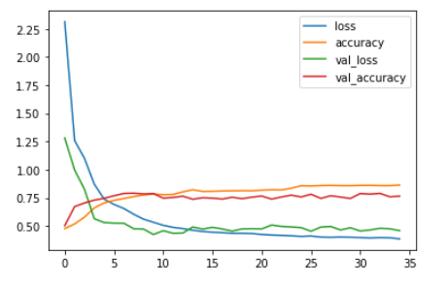
ML VISUALIZATION

Slide 28
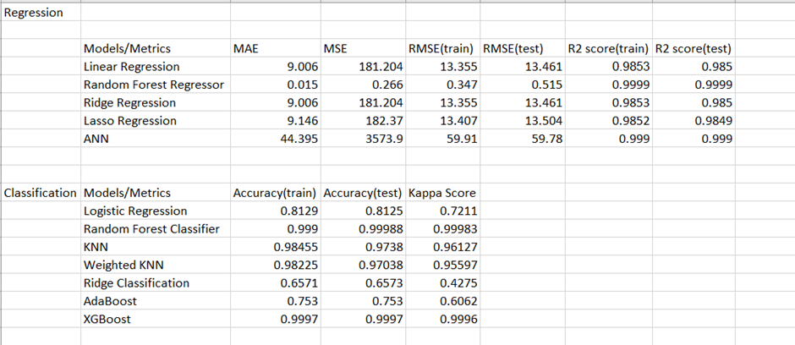
MODELS ACCURACY COMPARISON

Slide 29
DISCUSSION
For predicting AQI, all the algorithms work very well with the dataset. This is because the data is structured very well with very good records and the preprocessing done on the dataset fixes the missing values and makes the data optimal for passing to any model.
Logistic Regression, AdaBoost and Ridge Classification do not perform as well compared to the other models.
All the other models have very good accuracy which is above 95% and is thus recommended to use for this dataset.

Slide 30
CONCLUSION
More priority and resources have to be given to Bihar, Delhi, Gujarat, Manipur and Uttaranchal for repairing the AQI levels as they have high levels of pollution.
The task of forecasting pollutant levels is inherently hard because of the volatile and dynamic nature of the data and its variability in space and time.
However, the task of forecasting pollutant levels has been increasing in importance due to the effects of pollution on the population and the environment.
In this project we have use algorithmic techniques like Linear Regression,Random Forest Regression,Logistic Regression, Random Forest Classifier, KNN, ANN(Artificial Neural Networks) for forecasting levels of pollutants like NO2, SO2, PM2.5 and Air Quality Index (AQI), using publicly available data for India.

Slide 31
FUTURE WORK
The future work that remains for this dataset might be to see why algorithms like AdaBoost, Logistic Regression, Ridge Classification are not giving that good of an accuracy compared to the other models that are applied.
By using Hyper Parameter Tuning, one can run a series of experiments and based on Trial and Error, one can find out the best fitting parameters so that they also fit to the data very well.

Slide 32
REFERENCES
Ditsuhi Iskandaryan , Francisco Ramos and Sergio Trilles,”Air Quality Prediction in Smart Cities Using Machine Learning Technologies Based on Sensor Data: A Review”,Institute of New Imaging Technologies (INIT), Universitat Jaume I, Spain,Received: 07 February 2020; Accepted: 25 March 2020; Published: 1 April 2020
Mrs. A. Gnana Soundari MTech, (PhD) Associate Professor,Mrs. J. Gnana Jeslin M.E, (PhD) Assistant Professor,Akshaya A.C’s,”INDIAN AIR QUALITY PREDICTION AND ANALYSIS USING MACHINE LEARNING”,Jeppiaar Engineering College
Gaganjot Kaur Kang, Jerry Zeyu Gao, Sen Chiao, Shengqiang Lu, and Approaches”,Gang Xie,”Air Quality Prediction: Big Data and Machine Learning
Brunekreef B, Holgate ST. Air pollution and health. Lancet. 2002 Oct 19;360(9341):1233-42. doi: 10.1016/S0140-6736(02)11274-8. PMID: 12401268.
Jamal A, Nabizadeh Nodehi R. PREDICTING AIR QUALITY INDEX BASED ON METEOROLOGICAL DATA: A COMPARISON OF REGRESSION ANALYSIS, ARTIFICIAL NEURAL NETWORKS AND DECISION TREE. JAPH. 2017;2(1).
Marilena Kampa and Elias Castanas’,“Human health effects of air pollution”Laboratory of Experimental Endocrinology, University of Crete, School of Medicine, P.O. Box 2208, Heraklion, 71003, Greece. Received 4 June 2007, Accepted 10 June 2007, Available online 23 July 2007.
Yang Zhang, Marc Bocquet, Vivien Mallet, Christian Seigneur, Alexander Baklanov,Real-time air quality forecasting, part I: History, techniques, and current status, Atmospheric Environment,Volume 60,2012,Pages 632-655,ISSN 1352-2310
John Bachmann (2007) Will the Circle Be Unbroken: A History of the U.S. National Ambient Air Quality Standards, Journal of the Air & Waste Management Association, 57:6, 652-697, DOI: 10.3155/1047-3289.57.6.652

